Slide 1
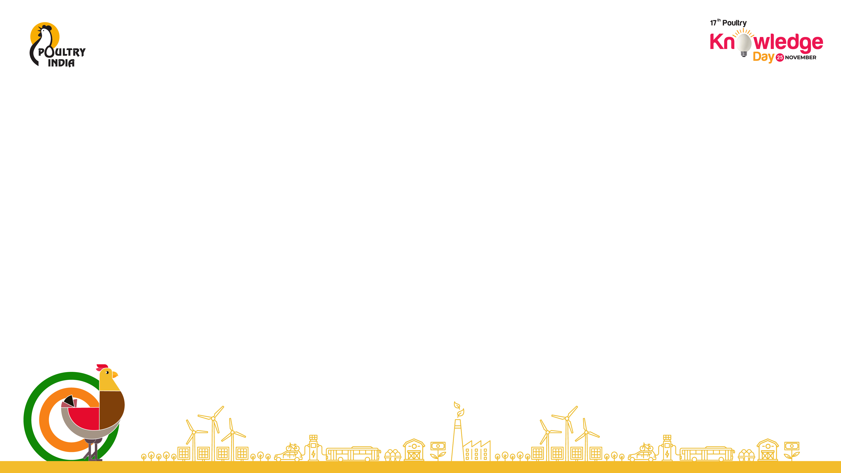
Outlook of GM Corn & Soya for Indian Poultry Sector: The Path to Sustainable and Profitable Poultry for Viksit Bharat
Deepak Pareek, Founder - HnyB

Slide 2

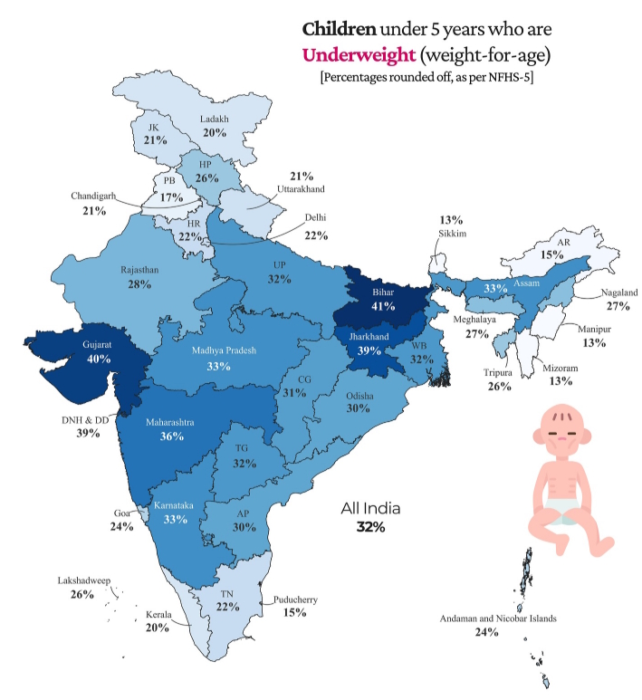
India’s Protein Paradox
India is a net food-surplus nation yet remains home to one of the world’s largest malnourished populations with 16.6% of the population is undernourished (FAO, SOFI Report 2023).
35.5% of children under 5 are stunted (NFHS-5), indicating chronic malnutrition. India has the highest number of stunted children in the world — approx 38 million. Stunting levels are higher than many African nations with lower per-capita income.
19.3% of under-5 children are wasted (NFHS-5), the highest rate globally. Severe wasting: 7.7% — 3x the global average (~2.5%). Indicates acute malnutrition and poor short-term nutrient intake, especially proteins.
Animal protein intake (milk, eggs, poultry, fish) is one of the lowest globally. Per-capita egg consumption: 100 eggs/year vs global avg 161. Per-capita poultry consumption: 5 kg/year vs global avg 30 kg+.
India loses ~3% of GDP annually to malnutrition (World Bank estimate).

Slide 3
Poultry as the Protein Engine for Viksit Bharat
Global meat consumption reaching 374 million tons (MMT) in 2024. Poultry meat remains the dominant category, contributing nearly 150 MMT (~41%). The anticipation for 2047 is that the poultry meat demand will be between 192-200 MMT.
Indian meat consumption reaching 10.25 MMT in 2024. Poultry meat with ~50% share contributing nearly 5 MMT. The anticipation for 2047 is that the poultry meat demand will be between 12-13 MMT. While we will need 195-210 billion eggs compared to 138.4 billion produced today.
India’s poultry sector is a heavyweight, valued at ₹2 lakh crore ($25 billion) as of 2024–25 and contributing around ~1.2% to India’s GDP or ~14% of livestock GDP, while supporting over 25 million livelihoods directly and indirectly. Anticipation is that it will be between 120-135 billion by 2047.
Sources: FAO, Niti Aayog, NIAP

Slide 4
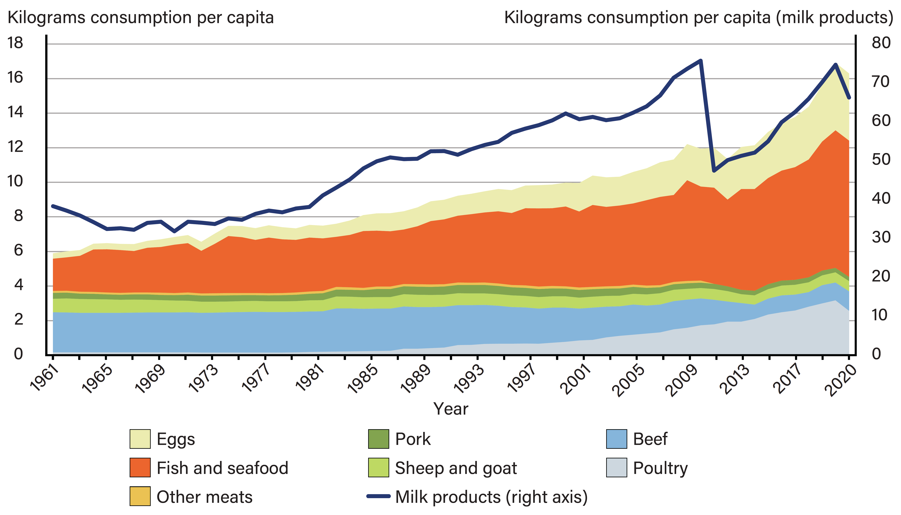
Animal Protein Consumption – Continuous Growth till 2019
Sources: FAO, Niti Aayog, NIAP

Slide 5
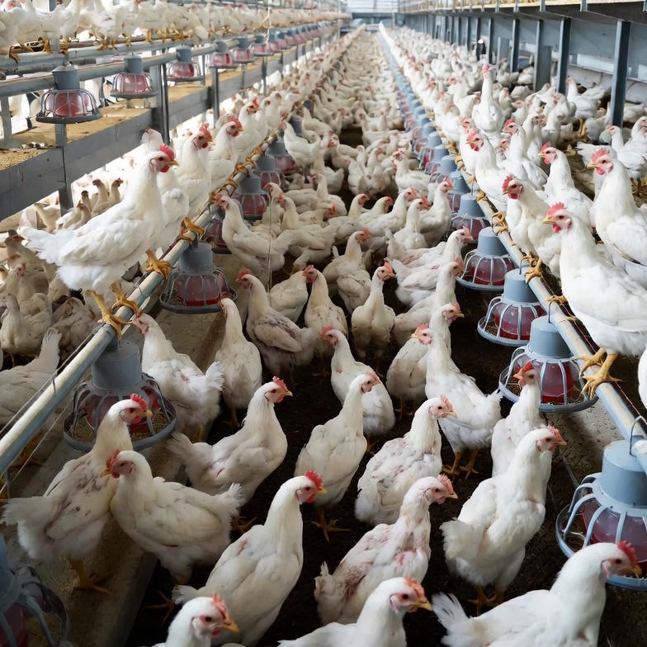
Bump in the Way
Since 2019 the growth is slowing down.
The growth in egg production declined from high of 10.2% in 2019-2020 to 3% in 2024-25.
The growth in meet production also slowed down from 6% in 2019-2020 to 4.9% in 2024-25.
To make Indian poultry sustainable and globally competitive, we must fix the feed first — not just the birds.
Sources: DAHD

Slide 6
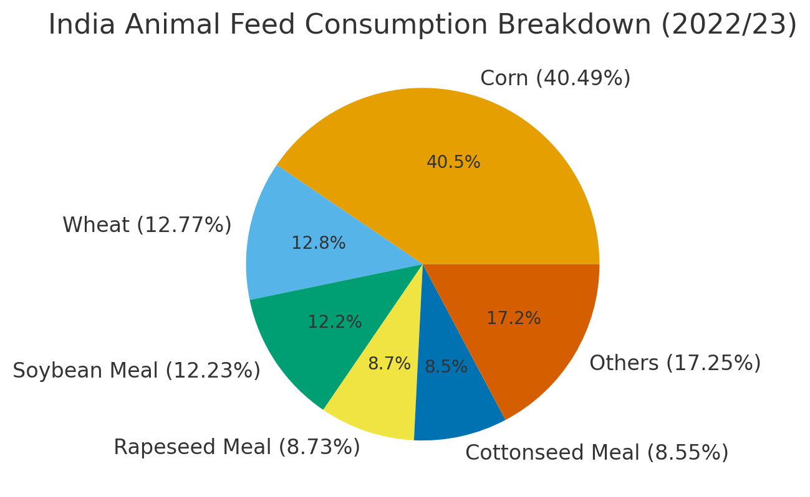
Feed Economics – The Twin Pillars: Corn & Soybean Meal
What triggered 2019-2020 reversal.
The price of both Maize and Soyabean spiked by average 10% and 14% hence increase in feed price.
The country is deficit in dry fodder (23%), green fodder (11%), and concentrate feed (29%).
The demand for concentrate feed will increase from 53 MMT in 2024-25 to 127 MMT. Demand for total corn will grow from 43 MMT to 103 MMT and Soyabean from 10 MMT to 43 MMT.
The shortage is expected to worsen owing to competing demands for land, climate change impacts, and ethanol policy.

Slide 7
Who Pays for Poor Productivity?
India Yields
India Imports vs Consumption
10% Higher Cost of Production
Sources: USDA/FAO/MoC
Meal – Soyabean FoB

Slide 8
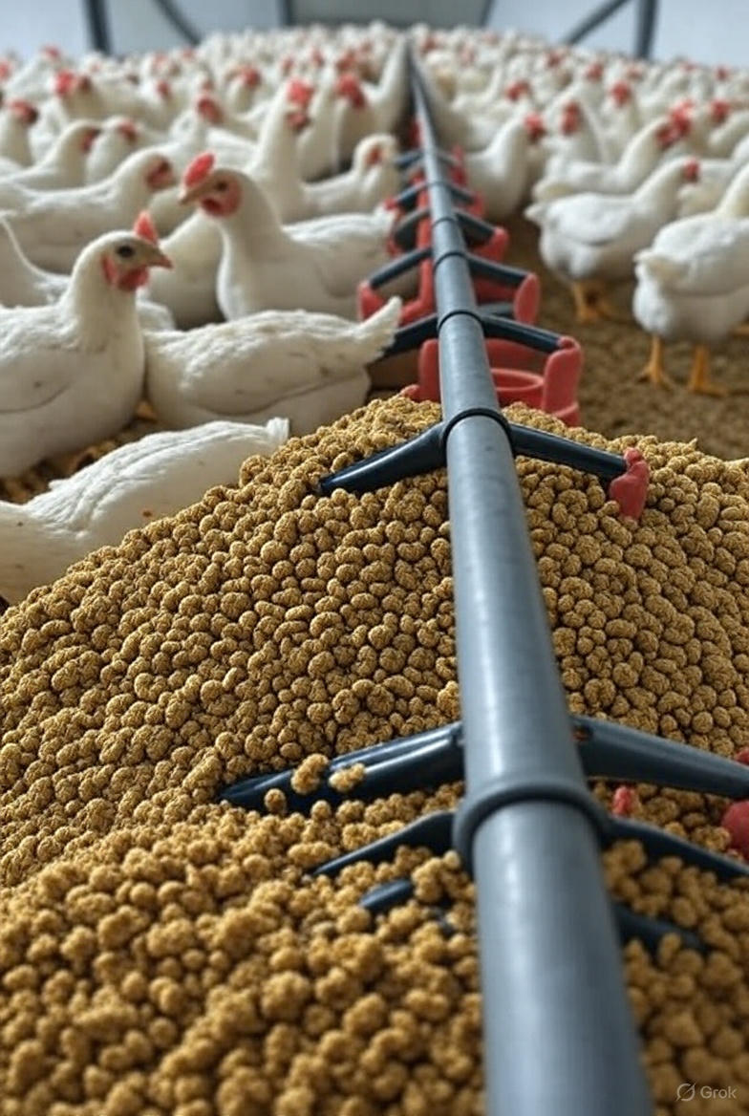
Import Vs Grow
With current constraints of land availability, estimated reduction of 4% yields of Maize and 3.8% in soyabean till 2047 due to climate change, nearly flat productivity growth in case of soyabean over past decade and limited production gains in case of maize, if we do not change our mindset, INDIA will be forced to IMPORT 55-65% of our animal feed concentrate requirement.
Feed accounts for 70% of production cost; feed volatility drives farmer distress.
India’s maize and soya yields are 25–40% below global average and 1/3rd of top players, with price often 25–40% higher than global price (Brazil/US).
Feed substitution with DDGS and other suboptimal ingredients means lower protein efficiency in the final product.

Slide 9
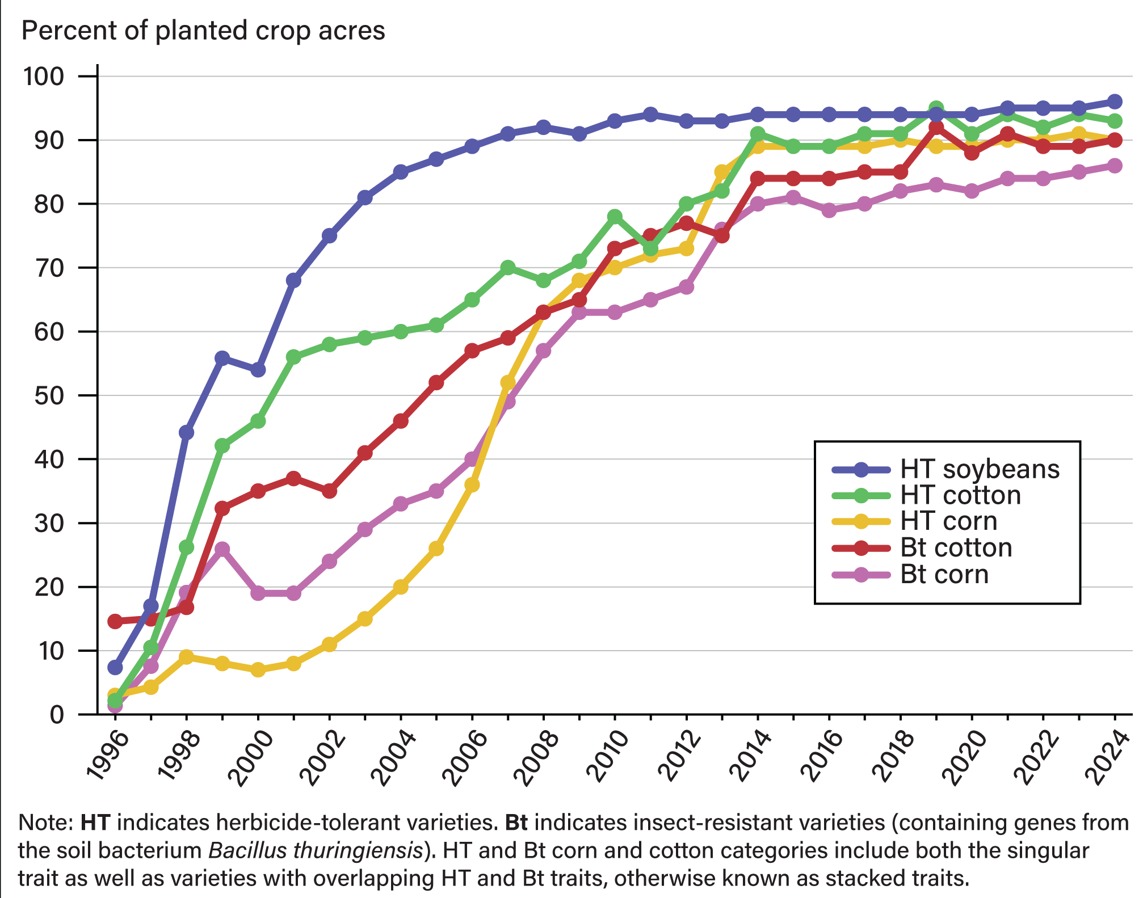
Understanding GM Corn and GM Soya – Myths vs. Science
Over 25 years of research, 900+ studies, and hundreds of independent research groups have reached the same conclusion. GMOs are not a health hazard.
In fact, they have reduced pesticide use, cut crop losses, and even improved nutrition in many cases.
“GM foods currently available on the international market have passed safety assessments and are not likely to present risks for human health.” - WHO
The controversies that remain—about corporate control of seeds, pesticide policies, or farmer income—are real and important, but they are economic and social debates, not food safety issues.

Slide 10
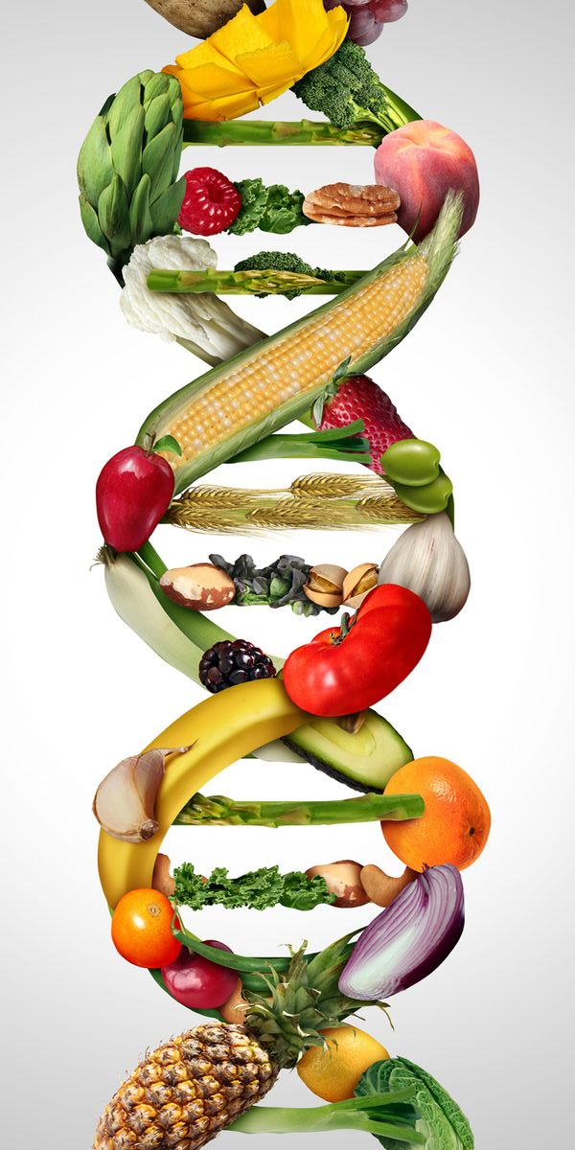
consensus is not just strong, it is global
WHO: GM foods on the market are not likely to present risks.
FAO/WHO Codex Alimentarius: Established international safety assessment standards for GM foods.
EFSA (EU): Approved GMOs are “as safe as their conventional counterparts.”
US National Academies: No evidence GM foods are riskier than conventional.
Royal Society (UK): “No evidence that a crop is dangerous simply because it is GM.”
European Commission (EU): GMOs are not inherently riskier.
Health Canada: GM foods are as safe and nutritious as non-GM foods.
FSANZ: GM foods approved only after extensive safety checks; approved varieties are safe.
Ministry of Agriculture and Rural Affairs (MARA) (China): GM staple food crops, like corn and soybean, gene-edited rice, and other approved varieties are safe.
This broad alignment is rare in science, underscoring how robust the evidence is. Even India has allowed genetic editing SDN1/SDN2.

Slide 11





Thank You!
me@dpareek.com
www.linkedin.com/in/dpareek
www.facebook.com/pareek.deepak
www.youtube.com/@Seed2Space

